Slide 1

1- Introduction to MLOPS
MLOps stands for Machine Learning Operations.
It's a set of practices that combines machine learning (ML) and IT operations.
The goal: To automate and streamline the end-to-end process of developing, deploying, and monitoring machine learning models in production.

Slide 2
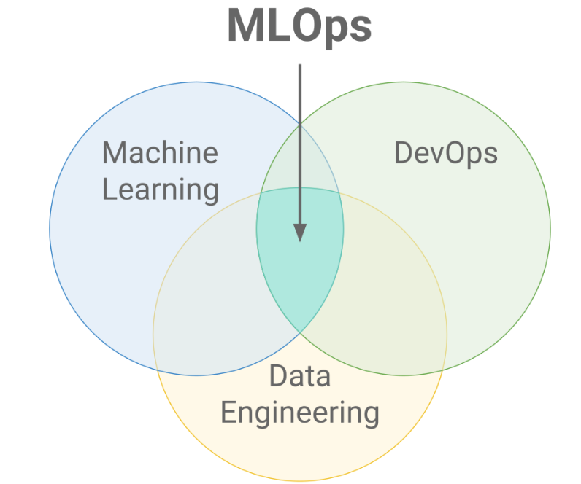
MLOPS is the fusion of machine learning and the operation for effective deployment of the ml model into production environment.
MLOPS also support continuous integration & continuous delivery or deployment

Slide 3
2- Why MLOps is Important?
ML Models are powerful but can be challenging to manage at scale.
Without MLOps, deploying machine learning models can become slow, error-prone, and difficult to monitor.
MLOps helps in:
Faster deployment of models.
Continuous monitoring and updating of models.
Collaboration between data scientists and operations teams.

Slide 4
To improve collaboration between data scientist & IT operation
To automate and streamline the deployment of machine learning models
To ensure reproducibility and scalability for machine learning
MLOps is important because once a machine learning model is trained, it doesn’t just "sit there.
It needs to be continuously improved, updated, and monitored
to make sure it delivers the right results over time. Without MLOps,
models could fail, get outdated, or become inefficient as
conditions change.

Slide 5

3- Key Components of MLOps
Version Control: Managing changes to data, code, and models.
Continuous Integration: Ensuring that the model code is always ready for deployment.
Model Deployment: Moving models into production environments for real-time predictions.
Model Monitoring: Checking the model’s performance and retraining it if necessary.

Slide 6
4- MLOps Workflow
Step 1: Data Collection – Gathering data for training the model.
Step 2: Model Training – Data scientists create and train machine learning models.
Step 3: Model Deployment – Models are deployed into production (used by real-world applications).
Step 4: Model Monitoring – Continuously monitoring how well the model is performing after deployment.
Step 5: Model Update – If the model’s performance degrades, it is retrained with new data

Slide 7

5- MLOps Tools
MLflow: A platform for managing the ML lifecycle.
Kubeflow: Helps automate the deployment of ML workflows on Kubernetes.
Docker: Used to containerize models, making it easier to deploy them in different environments.
TensorFlow Extended (TFX): A production-ready platform for deploying machine learning pipelines.
Cloud platform also like (AWS, AZUR, GCP)
Databricks

Slide 8
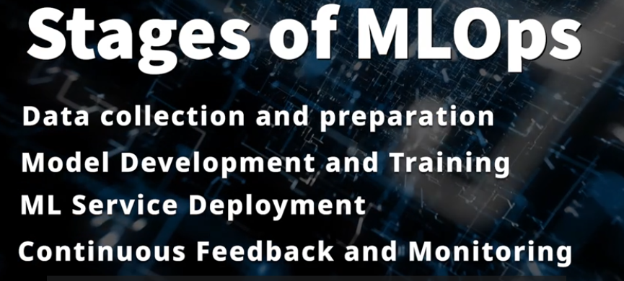
Stages of MLOPS
Data collection & preparation →
Data ingestion, data preparation & data exploration
Define goal & identify data sources
Prepare, label & explore raw data
Model development and Training→
Getting data ready for ml model
Perform model training & validation
Evalution of ml models – (MLPIPELINE)
Ml service Deployment→
Integrate with existing Application
Create frontend
Containerize the application
API service & Model endpoint
Continuous Feedback and Monitoring→
Track data & infrastructure
Model
Application

Slide 9
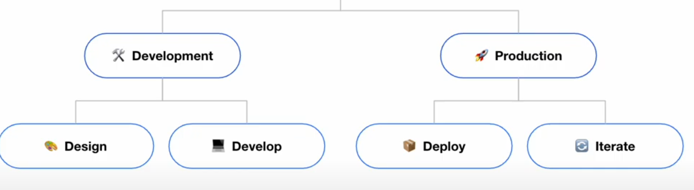

Slide 10
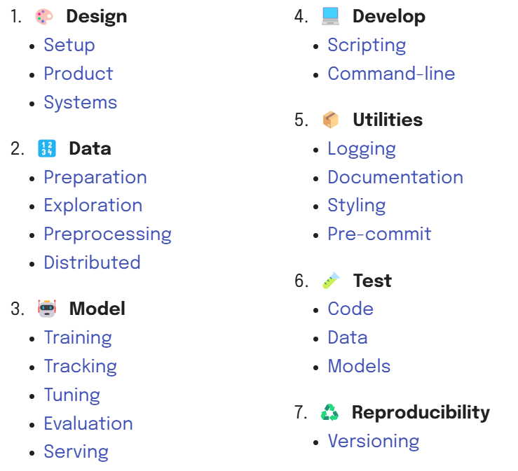
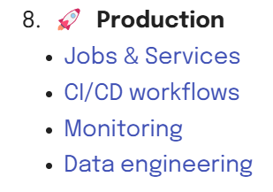

Slide 11
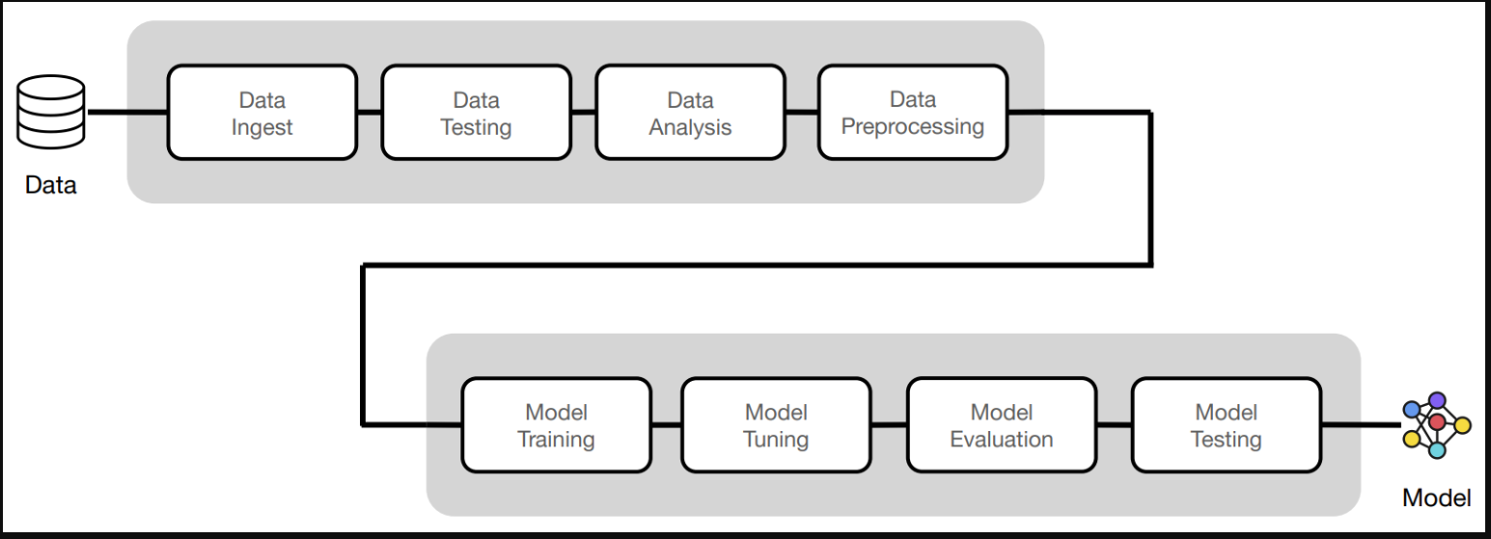

Slide 12
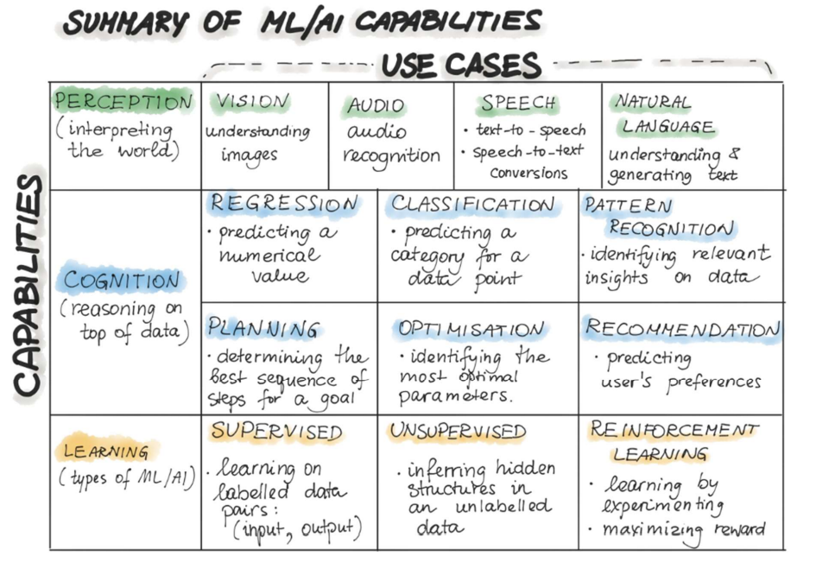

Slide 13
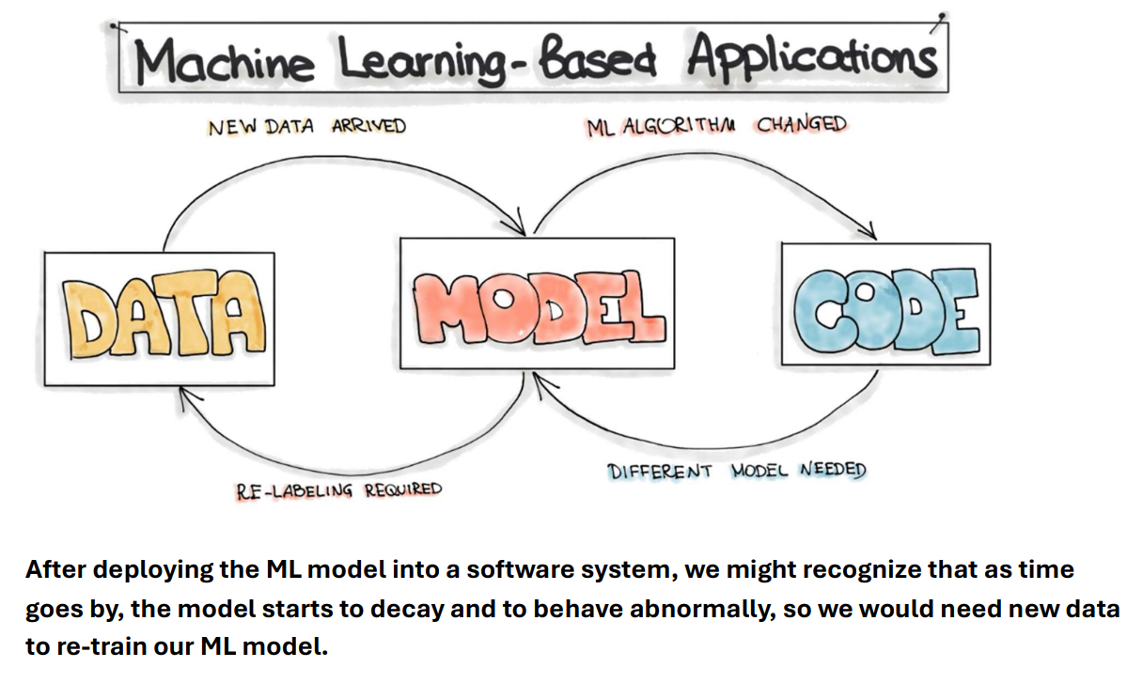

Slide 14
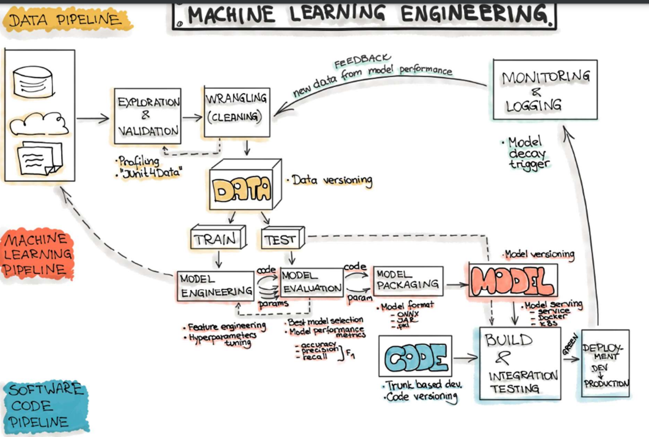

Slide 15
THANK YOU

